Slide 1
New approaches to sleep monitoring
Conor Heneghan PhD *,
Chief Engineer, ResMed Strategy and Ventures
Adjunct Associate Professor, School of Electrical, Electronic and Communication Engineering, University College Dublin
*Disclosure: Speaker is an employee and shareholder of ResMed

Slide 2
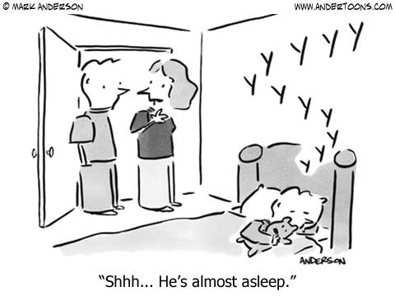
Overview
Introduction
Current approaches to measuring sleep
Non-contact radio frequency biomotion sensing
Open research questions

Slide 3
Who are ResMed?
Global company head quartered in San Diego, which provides therapy for sleep disordered breathing and other respiratory disorders primarily using non-invasive ventilation technology
Approximately 4000 people worldwide, $1.7B annual revenue
25-year old company, founded in Sydney, Australia
High emphasis on best-in-class products and the clinical research underpinning those products

Slide 4
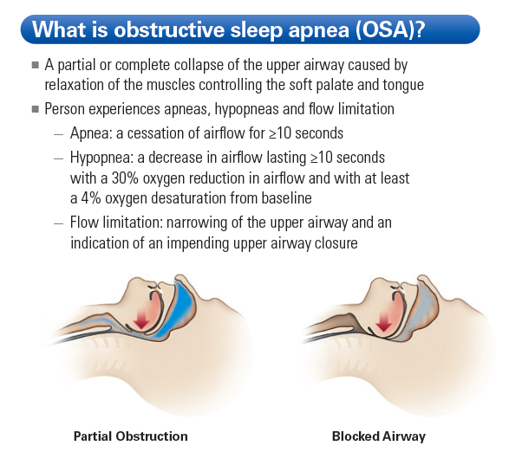
Sleep Disordered Breathing

Slide 5
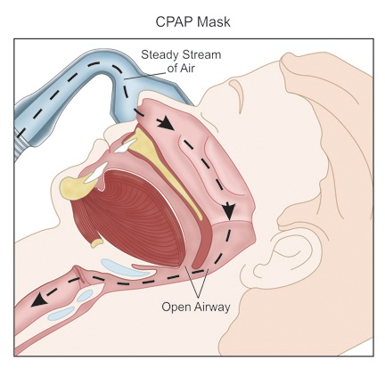
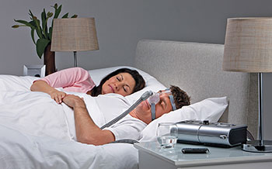
Sleep Disordered Breathing

Slide 6
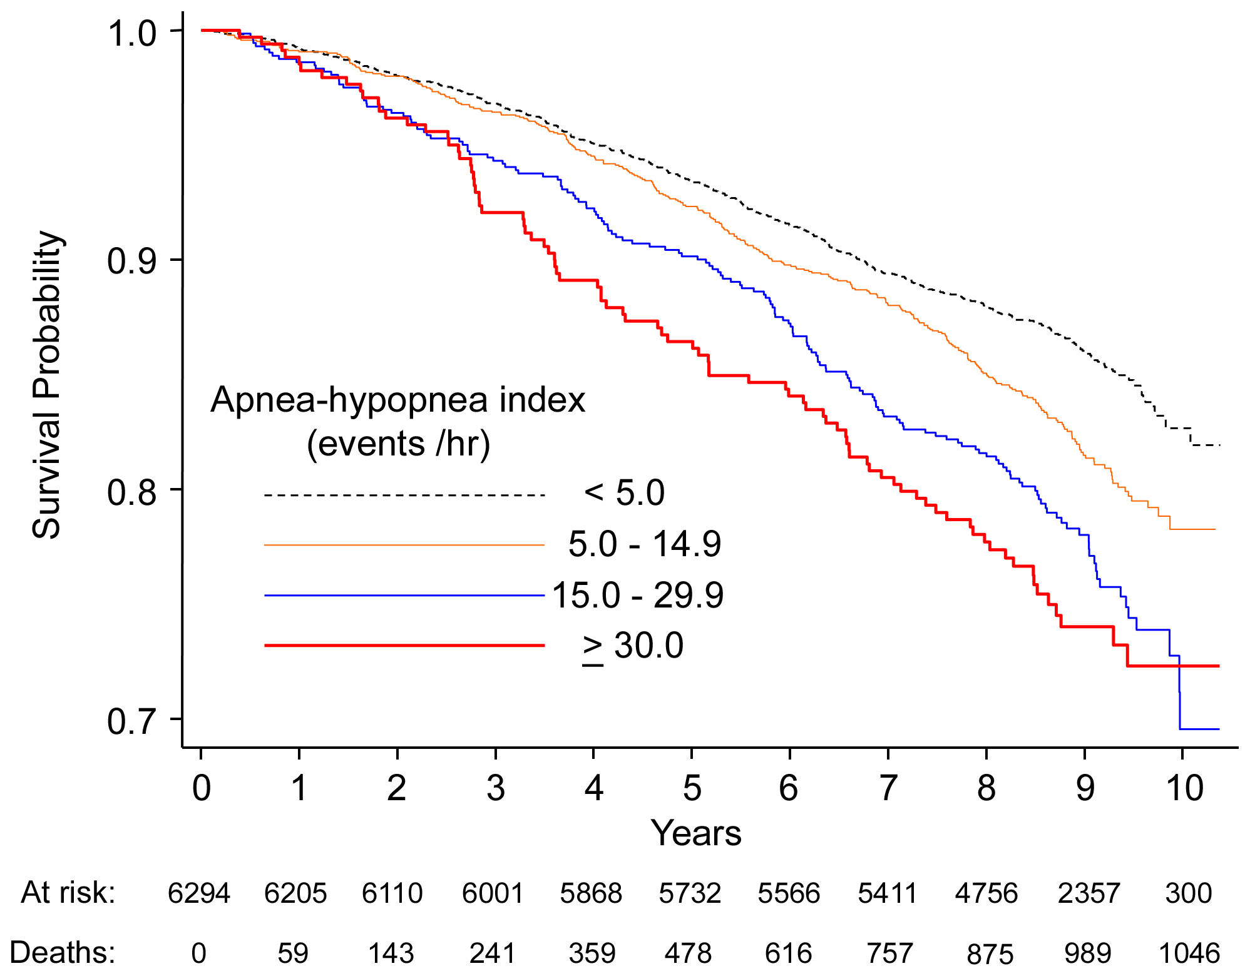
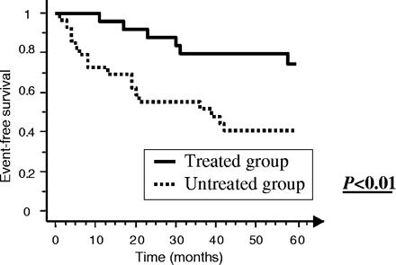
Why should we care about SDB?
Sleep-Disordered Breathing and Mortality: A Prospective Cohort Study, Punjabi et al., 2009, PLOS Medicine
Benefits of obstructive sleep apnoea treatment in coronary artery disease: a long-term follow-up study, Milleron et al., Eur Heart J., 2004

Slide 7
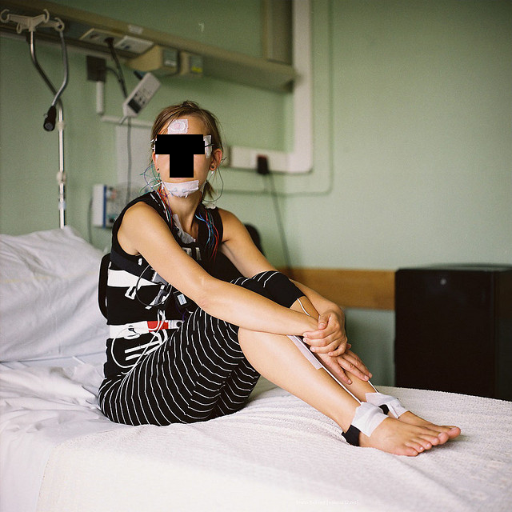
Classical Sleep Measurement: Polysomnogram
Polysomnogram
Nasal airflow
Chest effort
Abdominal effort
Oximetry
EMG (legs and chin)
EOG
EEG (F4/M1, C4/M1, O2/M1)
ECG

Slide 8
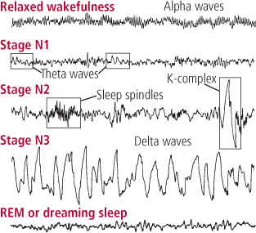
Classical Sleep Measurement: Polysomnogram
Waves | Frequency
Alpha | 7.5-12.5 Hz
Theta | 4-7 Hz
Delta | 0.5-4

Slide 9
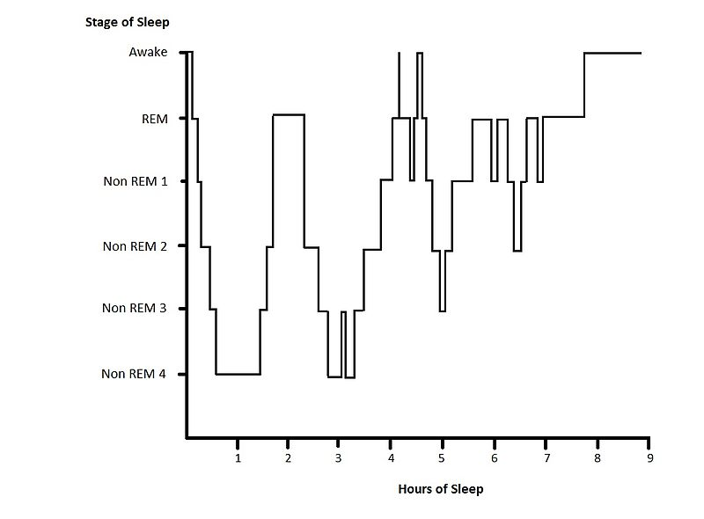
Classical Sleep Measurement: Polysomnogram
Gold standard sleep staging done by trained technician, reviewing
multiple EEG channels, and applying rules first formulated by Rechtshaffen and Kales in 1968 => AASM scoring manuals (2007)

Slide 10
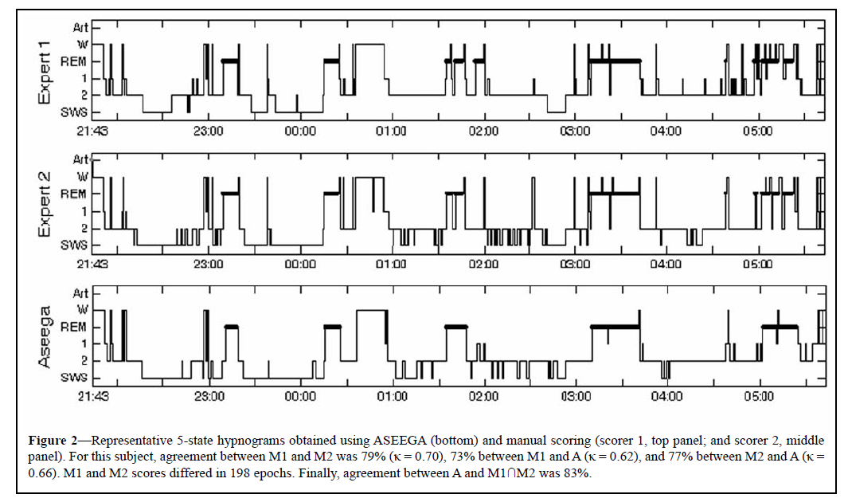
Classical Sleep Measurement: Polysomnogram
Berthomier at al., SLEEP, 2007.

Slide 11
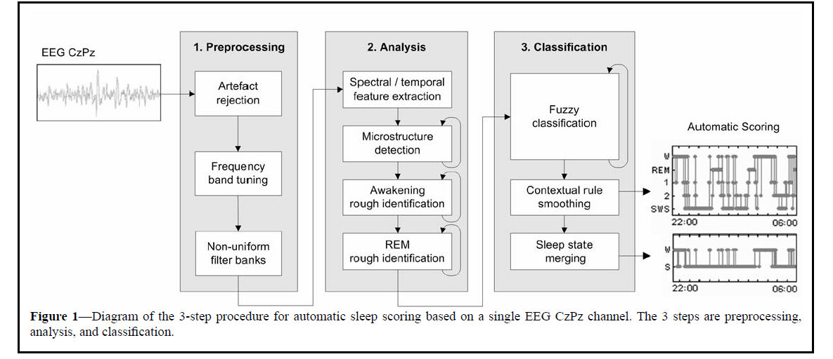
Single Channel EEG Measurements
96% agreement on sleep/wake scoring with expert consensus

Slide 12
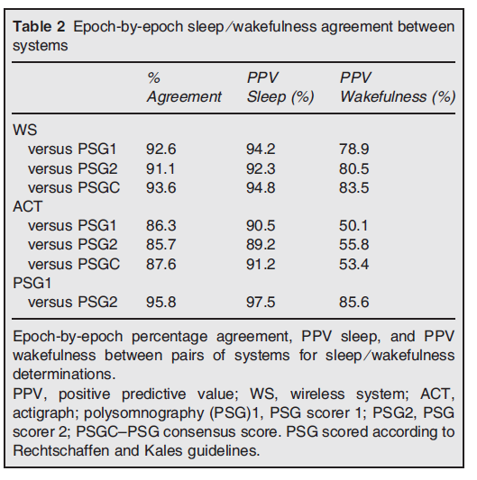
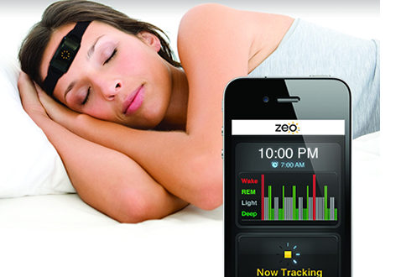
Consumer single channel EEG device

Slide 13
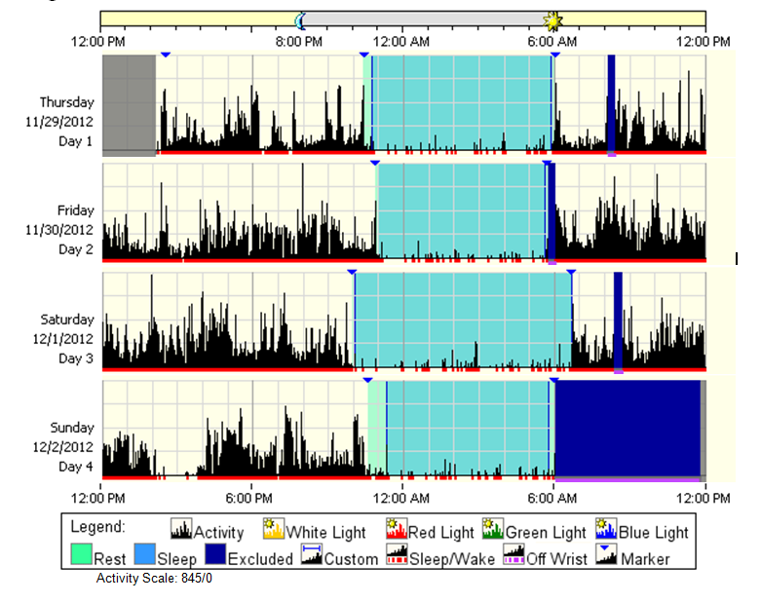
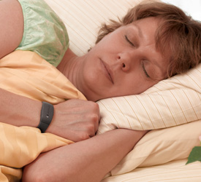
Actigraphy approaches to sleep measurement

Slide 14
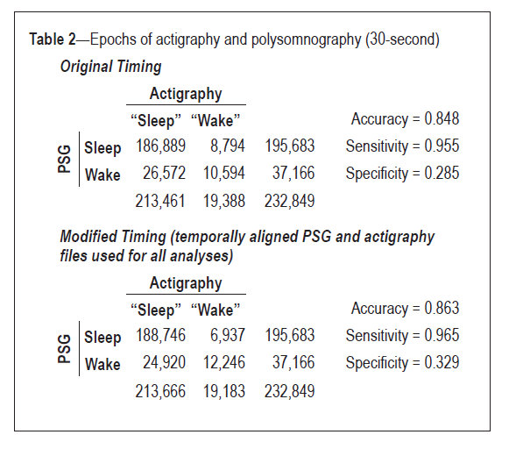
Accuracy of Actigraphy

Slide 15
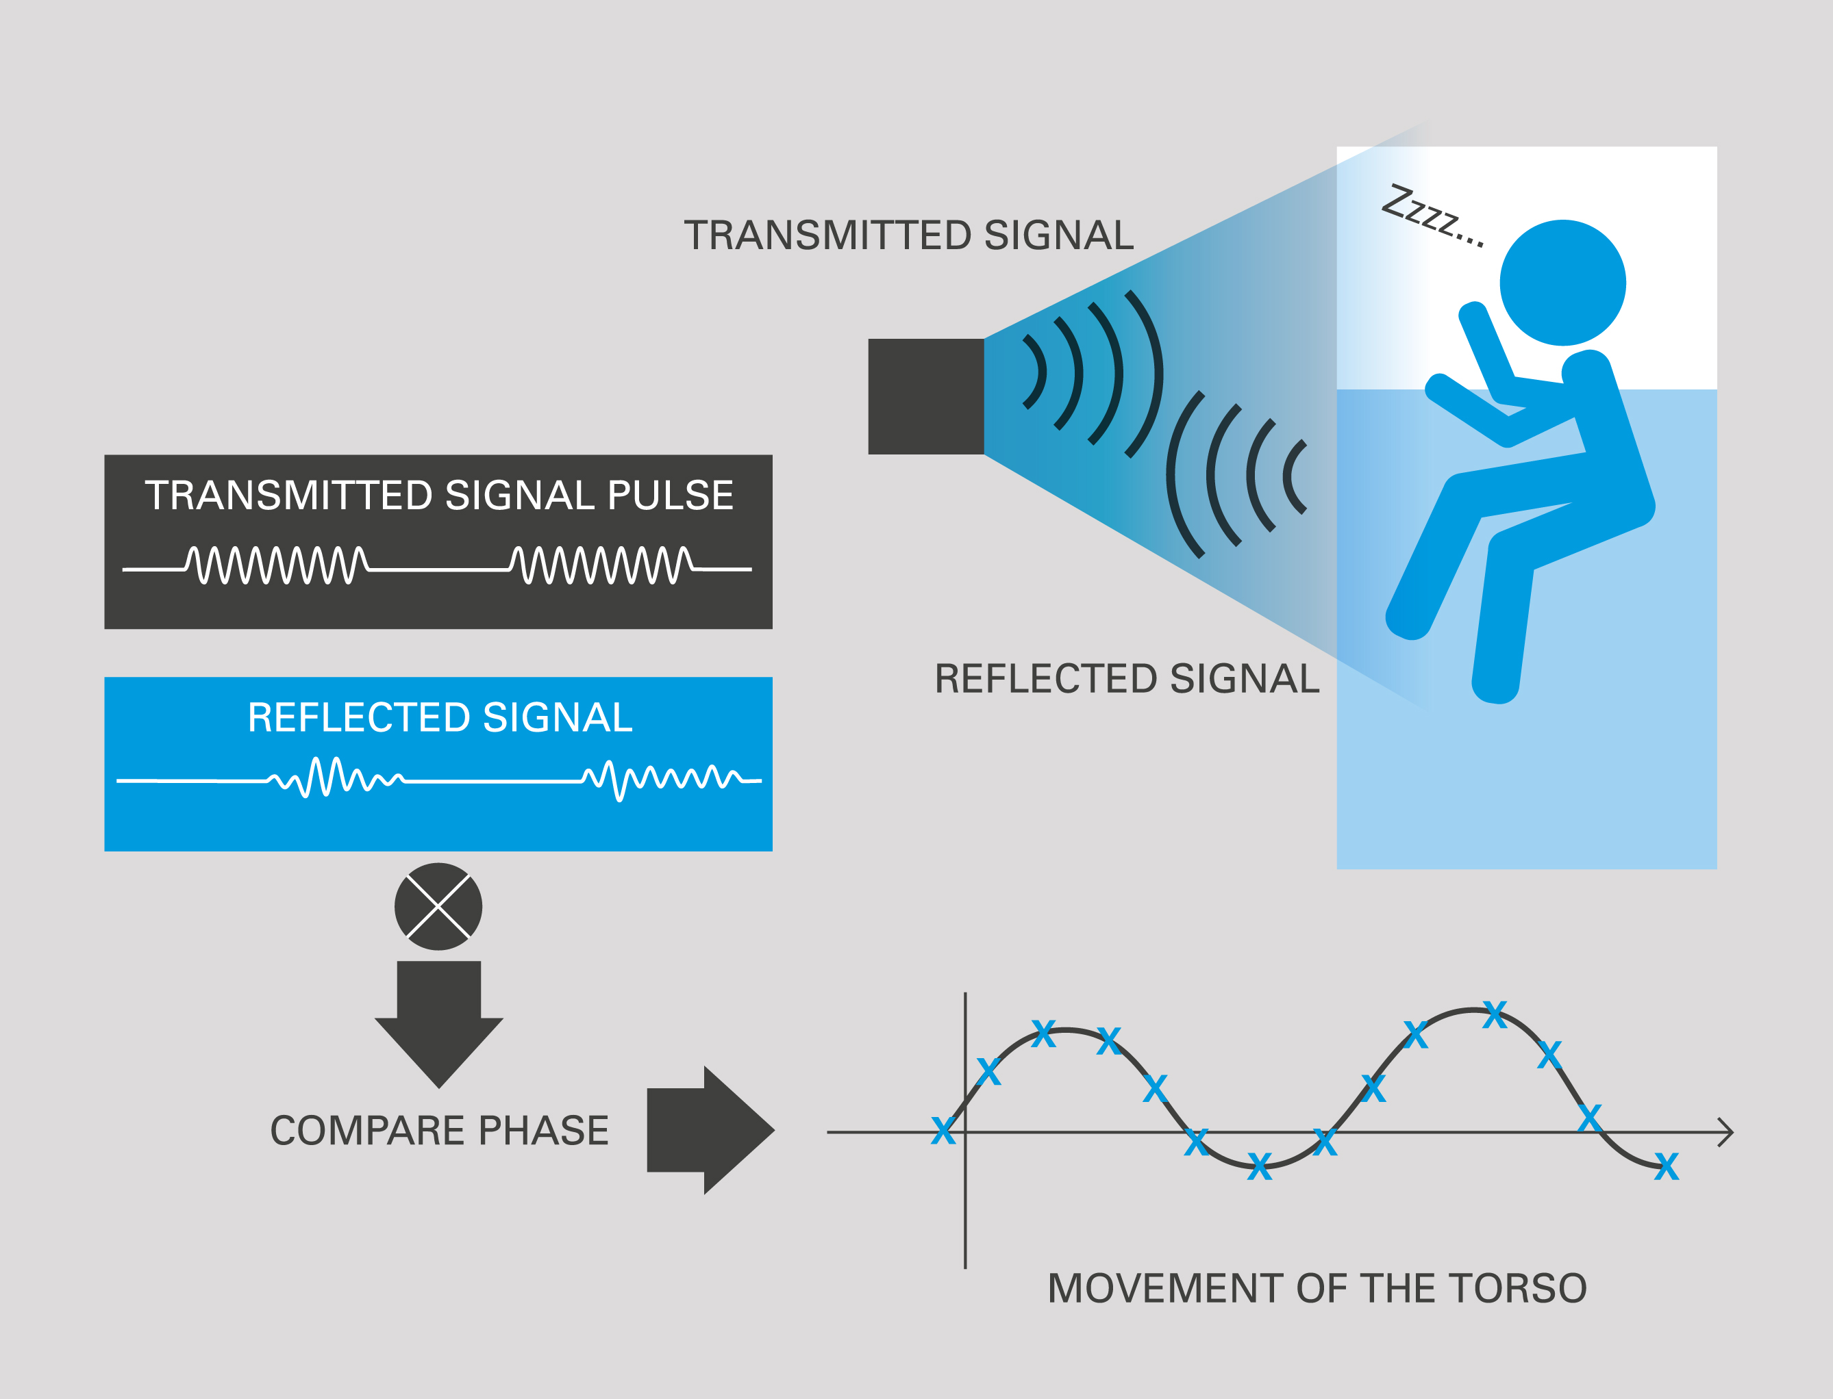
Radio Frequency Biomotion Sensing

Slide 16
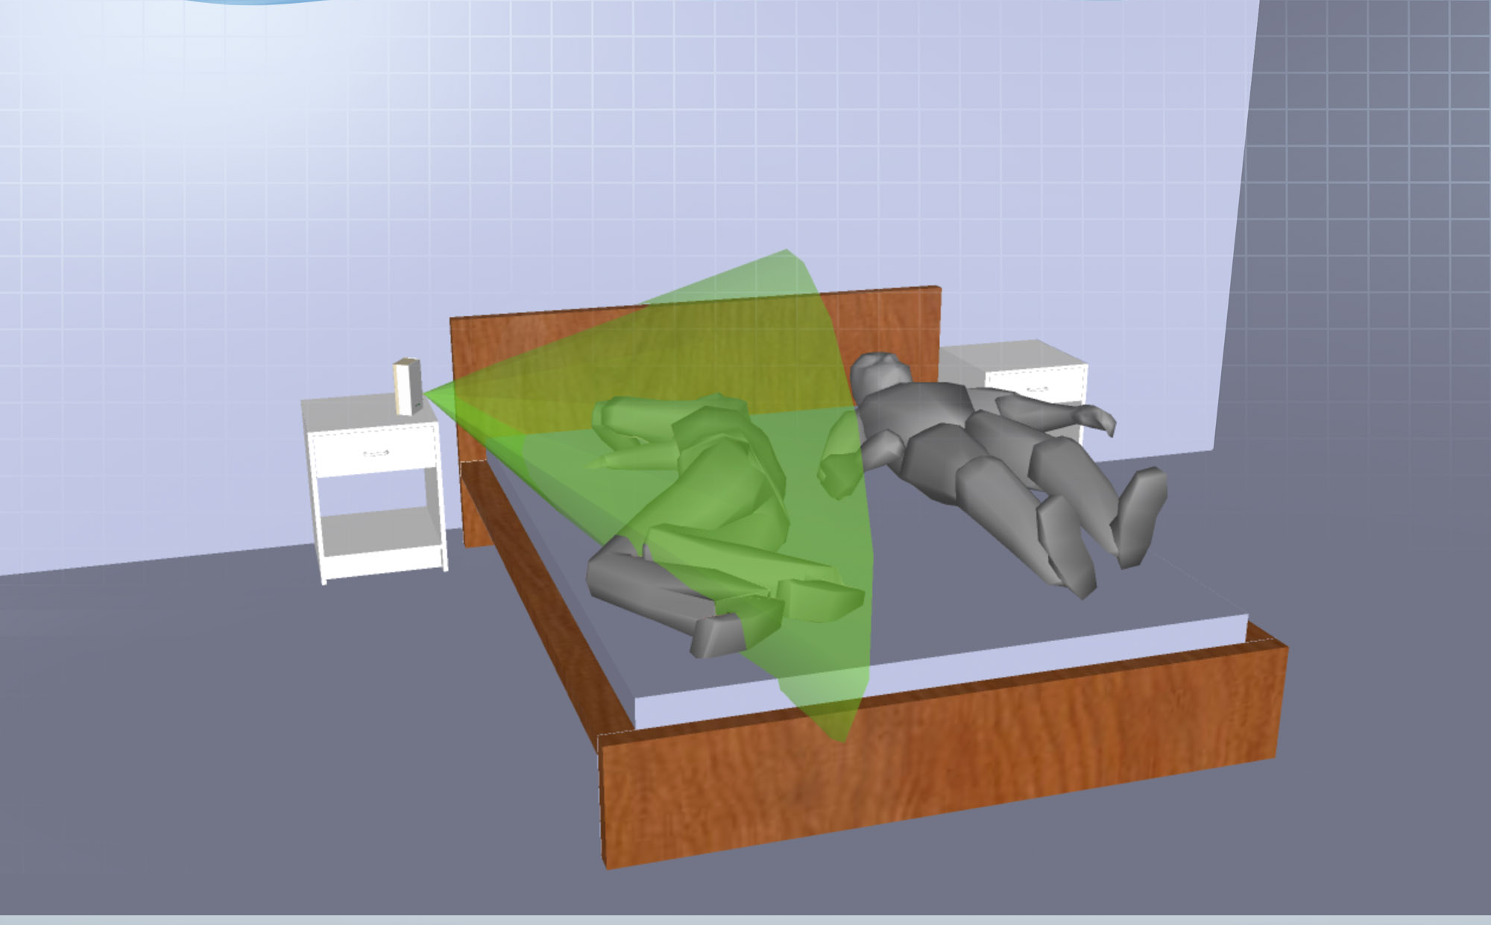
Zone of Sensing: “Range Gated”

Slide 17
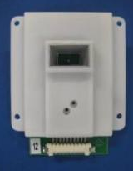
Technical Characteristics
Characteristic | Value
Frequency | 10.525 GHz or 5.8 GHz
Emitted Power | ~1 mW
Clearances | FCC, CE, ARIB
Range | ~1.3m
3 dB Beamwidth | +/- 30°
Power consumption | ~60 mW

Slide 18
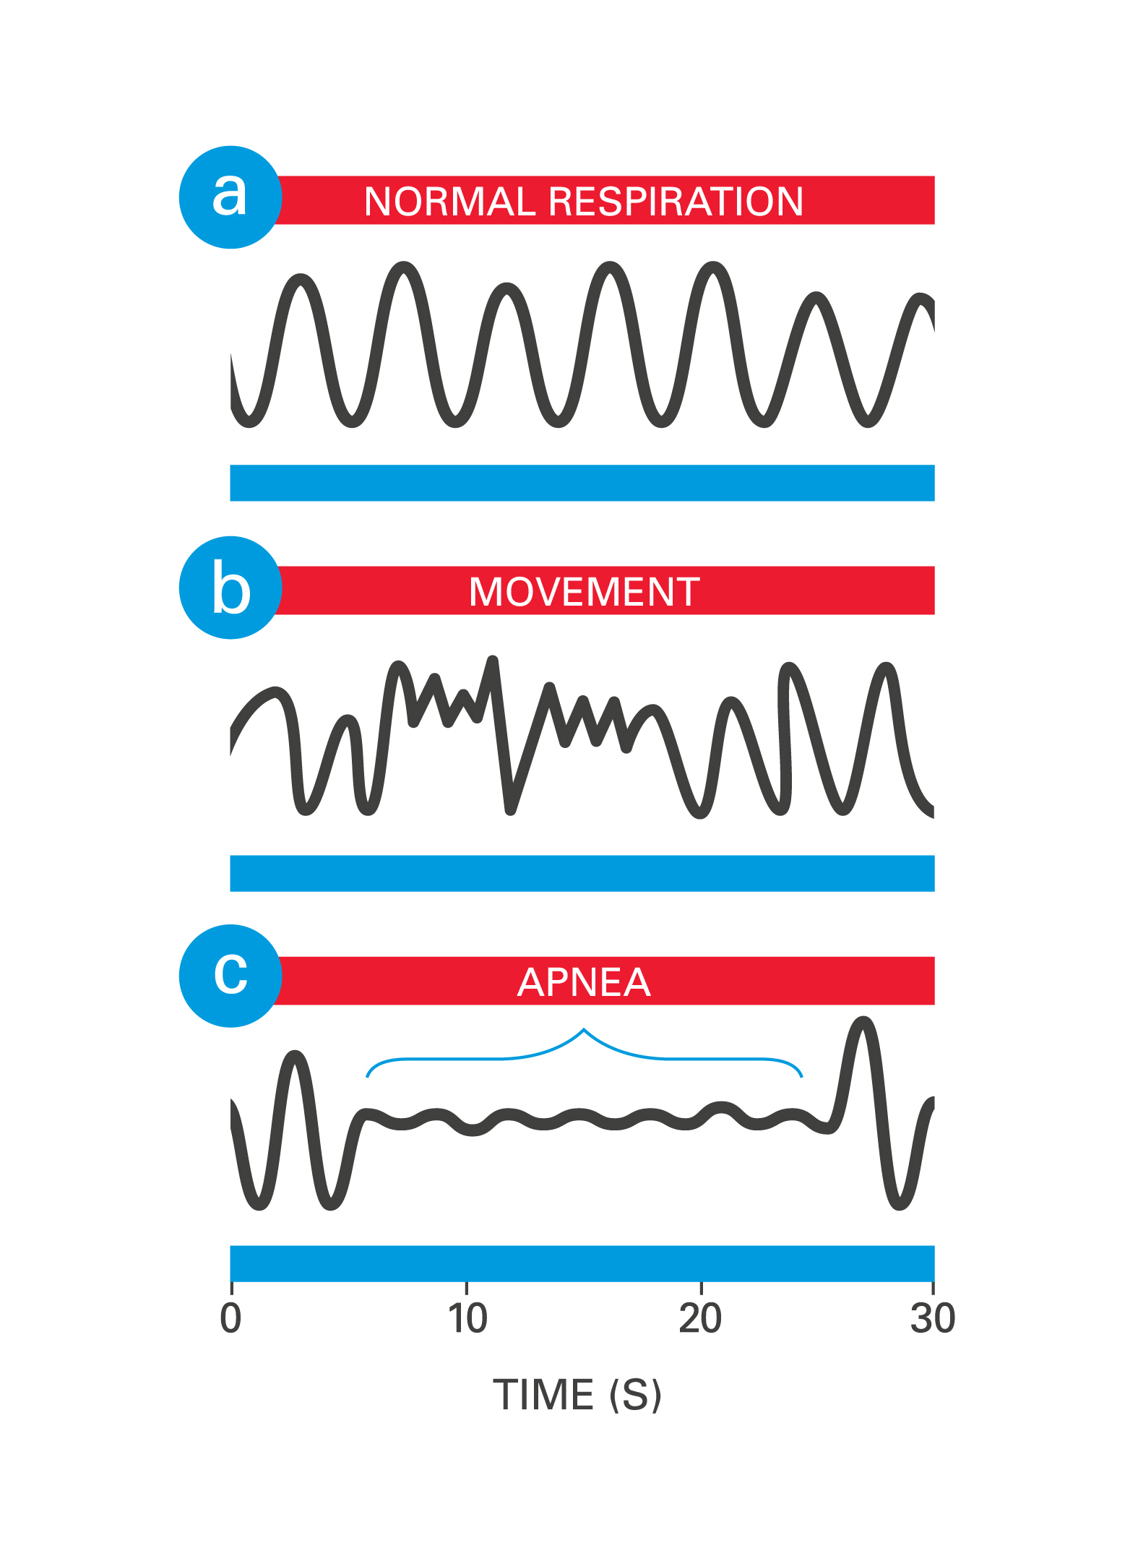
Radio Frequency Biomotion Sensing

Slide 19
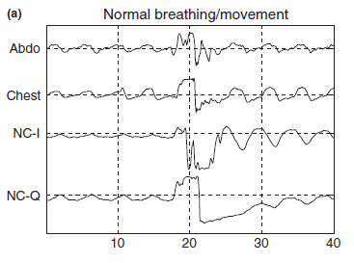
Radio Frequency Biomotion Sensing

Slide 20
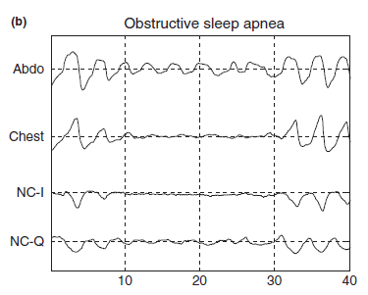
Radio Frequency Biomotion Sensing

Slide 21
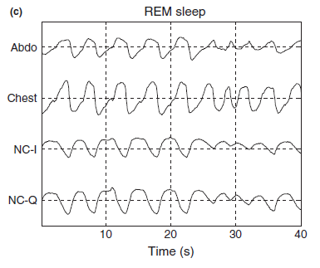
Radio Frequency Biomotion Sensing

Slide 22
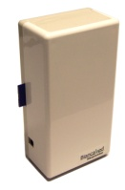
Signal Processing
Motion signal formation and digitisation
Separate into physiological components
Core signal processing
Motion Sensor
Attribute Extraction/ Pattern Recognition
Respiration
Movement / Motion

Slide 23
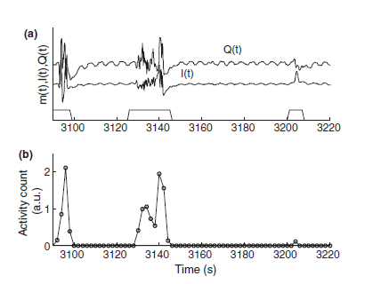
Detection of Movement

Slide 24
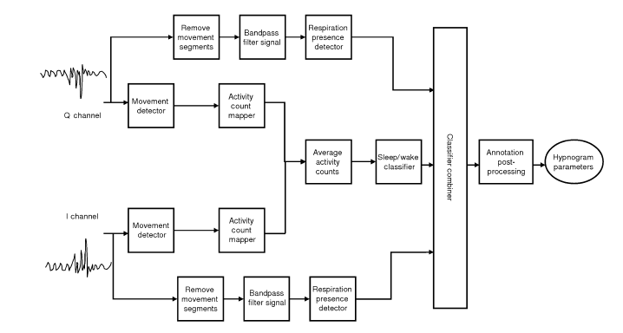
Signal Processing Steps

Slide 25
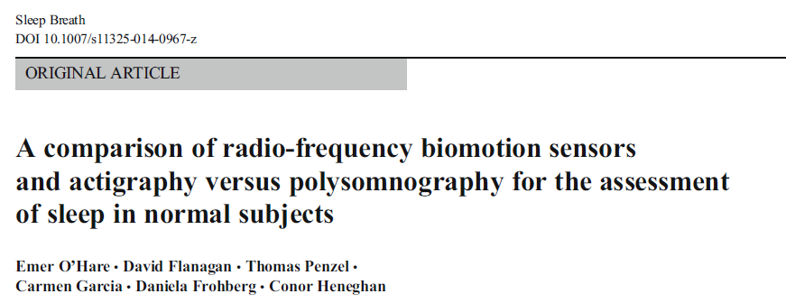
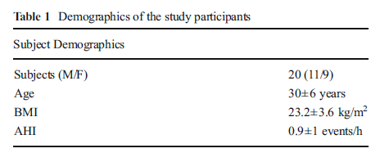
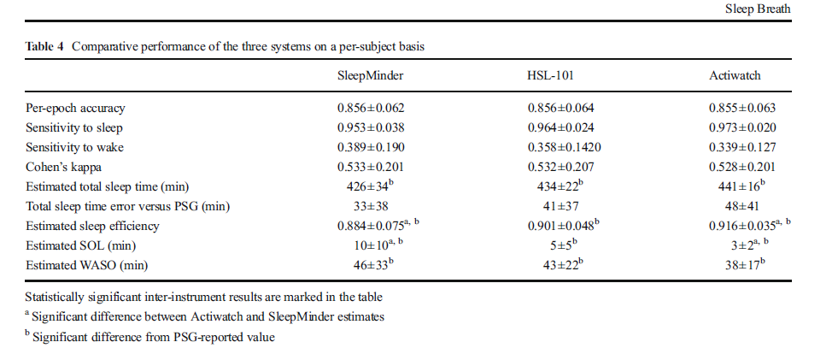
Initial Results on Sleep/Wake Staging

Slide 26
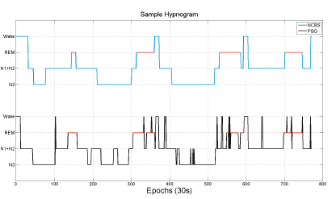
Hypnograms
Non-contact sensor
EEG

Slide 27
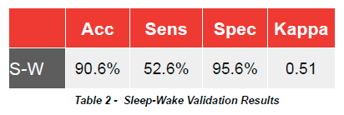
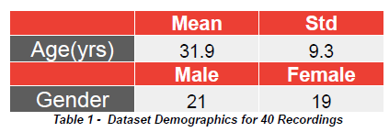
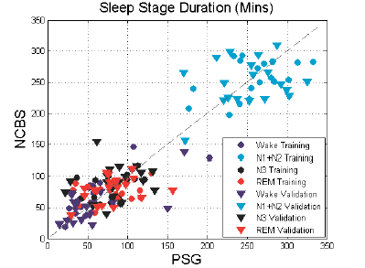
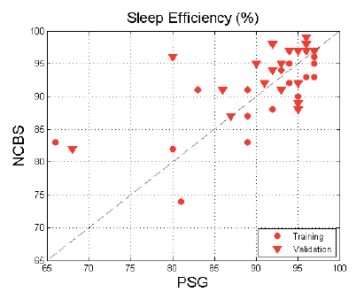
Latest Results on Sleep Wake Staging
Zaffaroni et al., European Sleep Research Society Annual Meeting, 2014

Slide 28
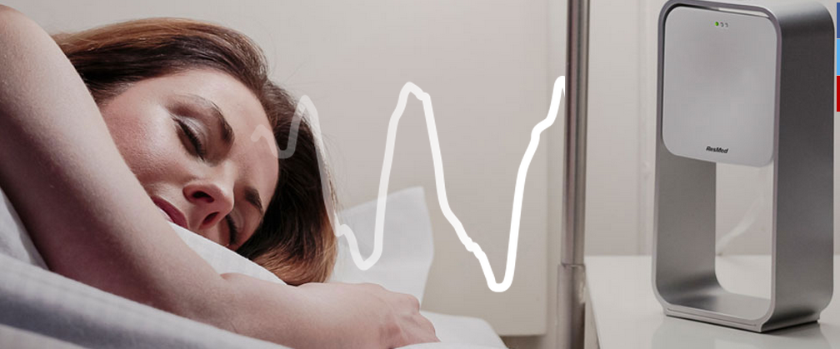
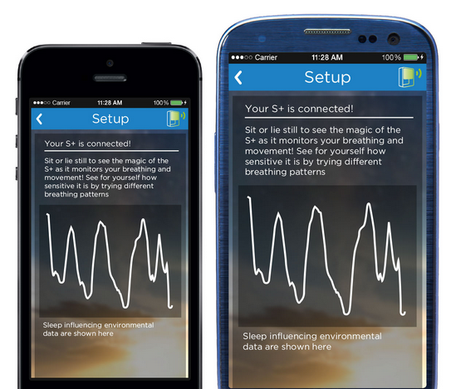
ResMed S+ Product

Slide 29
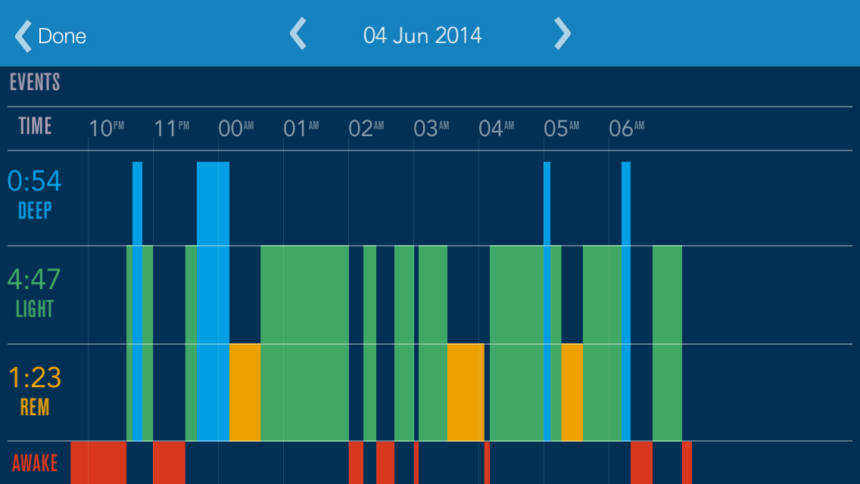
Radio Frequency Biomotion Sensing

Slide 30
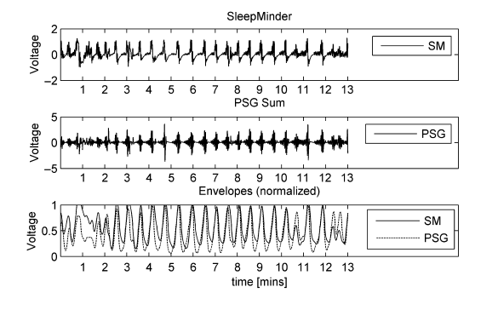
Respiratory Parameters: Detection of SDB

Slide 31
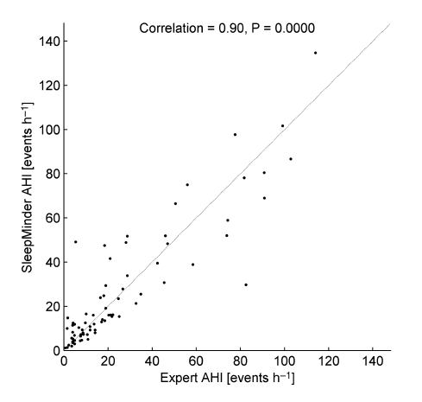
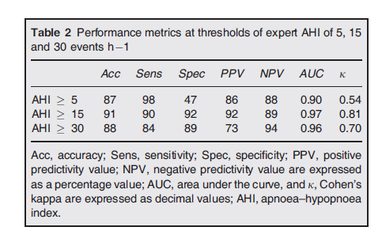
Respiratory Parameters: Detection of SDB

Slide 32
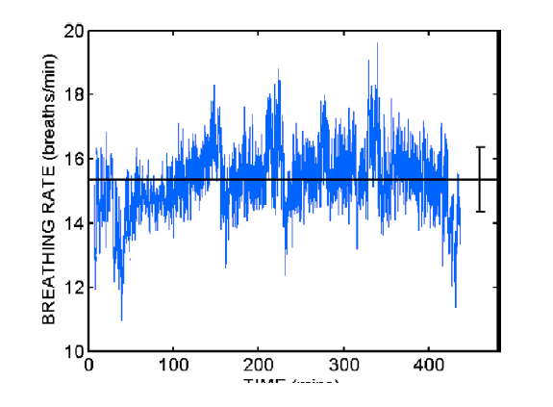
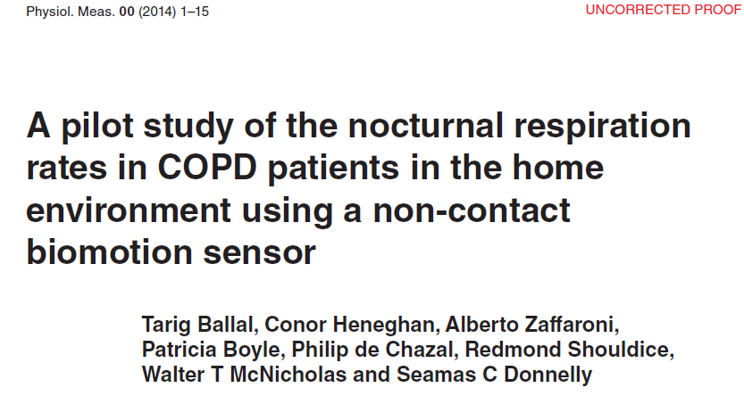
Respiratory Parameters: Respiration Rate

Slide 33
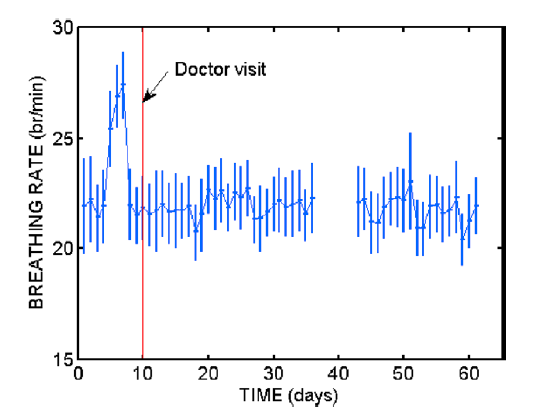
Respiratory Parameters: Respiration Rate

Slide 34
Open Questions
Ways to improve accuracy?
Sleep-onset latency estimation?
Validation across different population groups (severe insomniacs, heart failure, chronic back pain)
Validate if pharmacological effects on sleep EEG are seen in movement/respiration sleep measurements
What can we learn about population sleep characteristics?
Can this technology help in tracking patients with chronic diseases?

Slide 35
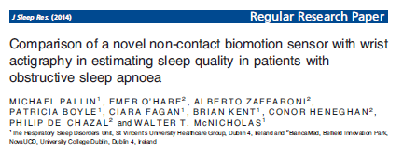
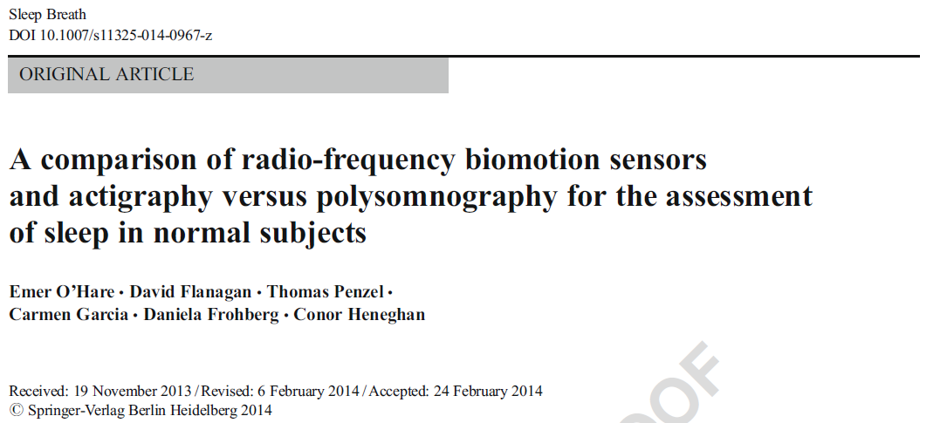
Publications

